Slide 1
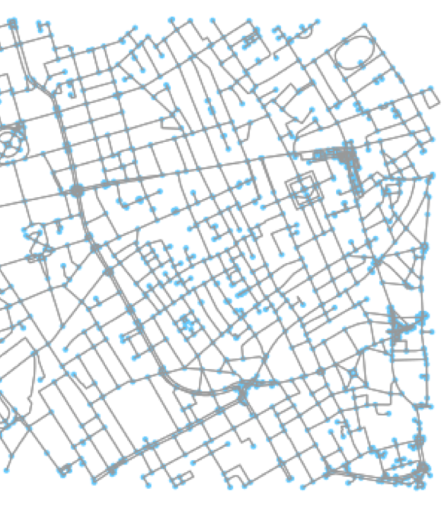
SNXA Street Network Analytics
A CDC Foundational Services API
Team 2 Hackathon 2018

Slide 2

What did we work on?
2 – Create open source code
3 – Create an Open API
4 – Contribute to Foundation Services
5 – Come up with custom scenario

Slide 3
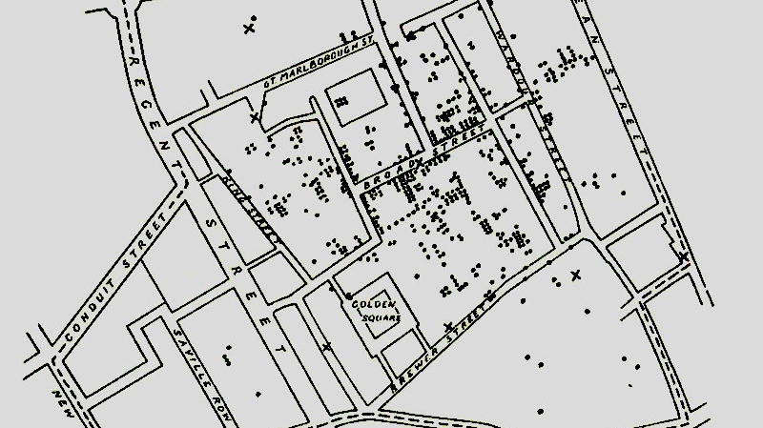
Scenario: Cholera Outbreak in London, 1854 Beginning with the end in mind
In 1854 Soho District, London, Dr. John Snow painstakingly mapped for weeks all the hundreds of deaths and 8 pump locations within Soho District. He also determined the walkability of the Broad Street pump and identified its catchment area.
Using SNXA, the Street Networks API from CDC Foundational Services, Dr. John Snow:
Could have saved a lot of time calculating the distance values between pairs of pump and death locations (within 5 minutes)
Could have figured out that the Broad Street pump was indeed the culprit in the Soho District cholera outbreak

Slide 4
Graph / Network Problems in Public Health
Design of disease surveillance and control strategies [2] - transport networks is a key factor in driving the speed and extent of disease spread
Violence prevention [1] – space-time features of crime hotspots
Emergency medical service location and assignment problem [3]
Population health studies – Obesity and supermarket access [4], food deserts [5], traffic volume and street walkability [6]
1 - Shiode, Shino, and Narushige Shiode. "Network-based space-time search-window technique for hotspot detection of street-level crime incidents." International Journal of Geographical Information Science 27.5 (2013): 866-882. 2 - Strano, Emanuele, et al. "Mapping road network communities for guiding disease surveillance and control strategies." Scientific Reports 8.1 (2018): 4744. 3 - Yang, Saini, Masoud Hamedi, and Ali Haghani. "Integrated approach for emergency medical service location and assignment problem." Transportation Research Record: Journal of the Transportation Research Board 1882 (2004): 184-192. 4 - Drewnowski, Adam, et al. "Obesity and supermarket access: proximity or price?." American journal of public health 102.8 (2012): e74-e80. 5 - Jiao, Junfeng, et al. "How to identify food deserts: measuring physical and economic access to supermarkets in King County, Washington." American journal of public health 102.10 (2012): e32-e39. 6 - Giles-Corti, Billie, et al. "School site and the potential to walk to school: The impact of street connectivity and traffic exposure in school neighborhoods." Health & place 17.2 (2011): 545-550.

Slide 5
The Street Networks API: Open Source Components
OSMnx: A Python package for downloading administrative boundary shapes and street networks from OpenStreetMap. It allows you to easily construct, project, visualize, and analyze complex street networks in Python with NetworkX. [1]
On GitHub [2]
Open Street Maps: A collaborative project to create a free editable map of the world. [3]
NetworkX: A Python package for the creation, manipulation, and study of the structure, dynamics, and functions of complex networks. [4]
1 - OSMnx: Python for Street Networks - https://geoffboeing.com/2016/11/osmnx-python-street-networks/ 2 – OSMnx GitHub Page - https://github.com/gboeing/osmnx. 3 – OSM Wikipedia - https://en.wikipedia.org/wiki/OpenStreetMap. 4 – NetworkX Page - https://networkx.github.io/

Slide 6

Street Networks API
Connect real time geospatial data (collected with GPS devices) to OSMnx street network nodes for performing network analytics
Accepts common data formats: CSV, JSON
Provides street network graph in GraphML format for analysis in other graph analytics software packages
Makes osmnx available for use in other programming languages that can access APIs

Slide 7
Open API

Slide 8
Uploading Data
2
1
Potential streaming input
Ethereum-powered smart contract for immutability, transparency and audit purposes

Slide 9
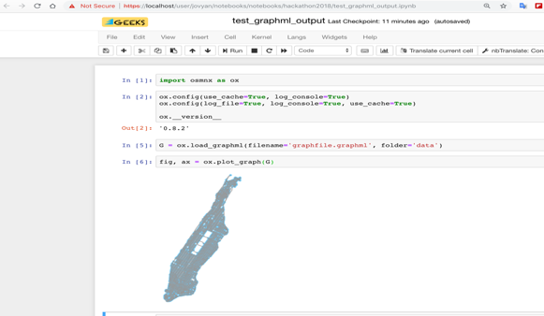
Using Jupyter Notebook running osmnx to test the GraphML output from the API
Call to graph_from_place osmnx function through the SNXA API
Resulting GraphML text output

Slide 10
Under the Hood
*
*
*

Slide 11
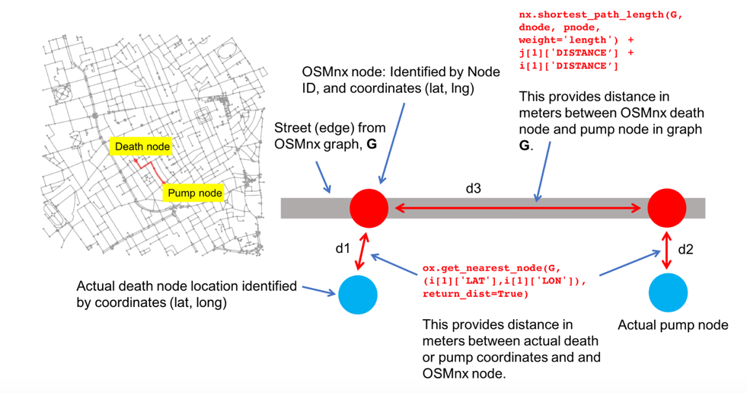
More OSMnx analytics for SNXA – 1

Slide 12
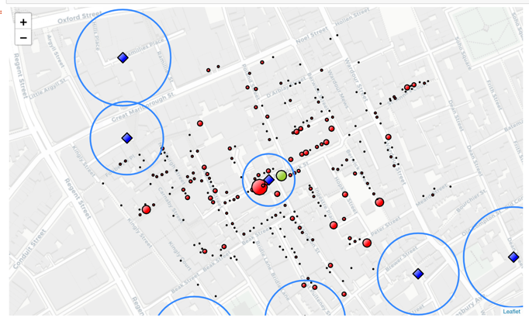
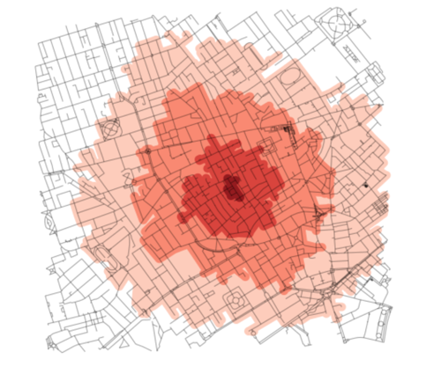
More OSMnx analytics for SNXA – 2
Point to point analysis using street network graphs help triangulate the culprit pump in the 1854 cholera outbreak.
Isochrone mapping to show walkability zones from a given point. In this figure, walkability zones from the Broad Street pump (can be output as shape file polygons).

Slide 13

QUESTIONS

Slide 14
Performing Analytics on Graph Data
nodes
edges
Street Network for Soho District, London, UK
Boeing, Geoff. "OSMnx: New methods for acquiring, constructing, analyzing, and visualizing complex street networks." Computers, Environment and Urban Systems 65 (2017): 126-139.

